Slide 1
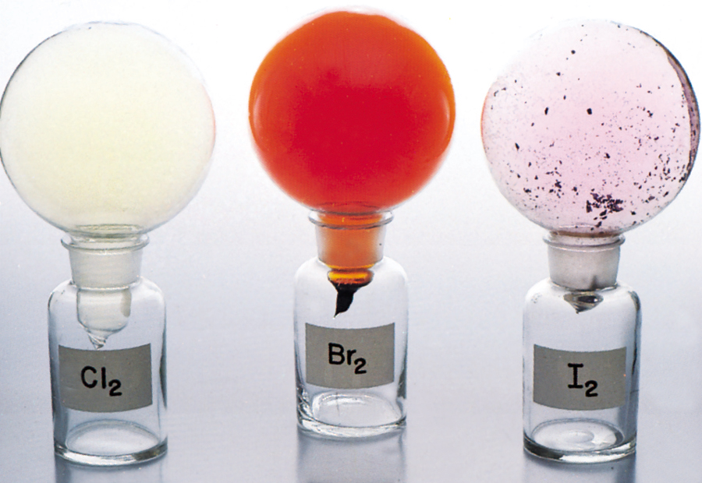
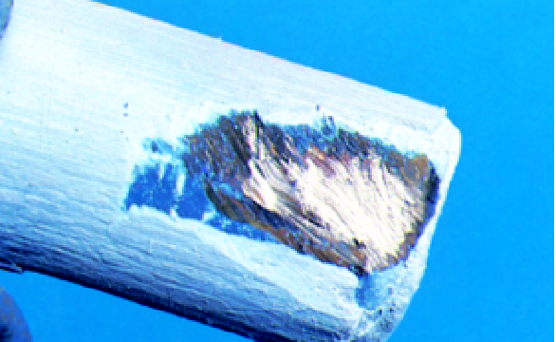
Periodic Relationships Among the Elements

Slide 2
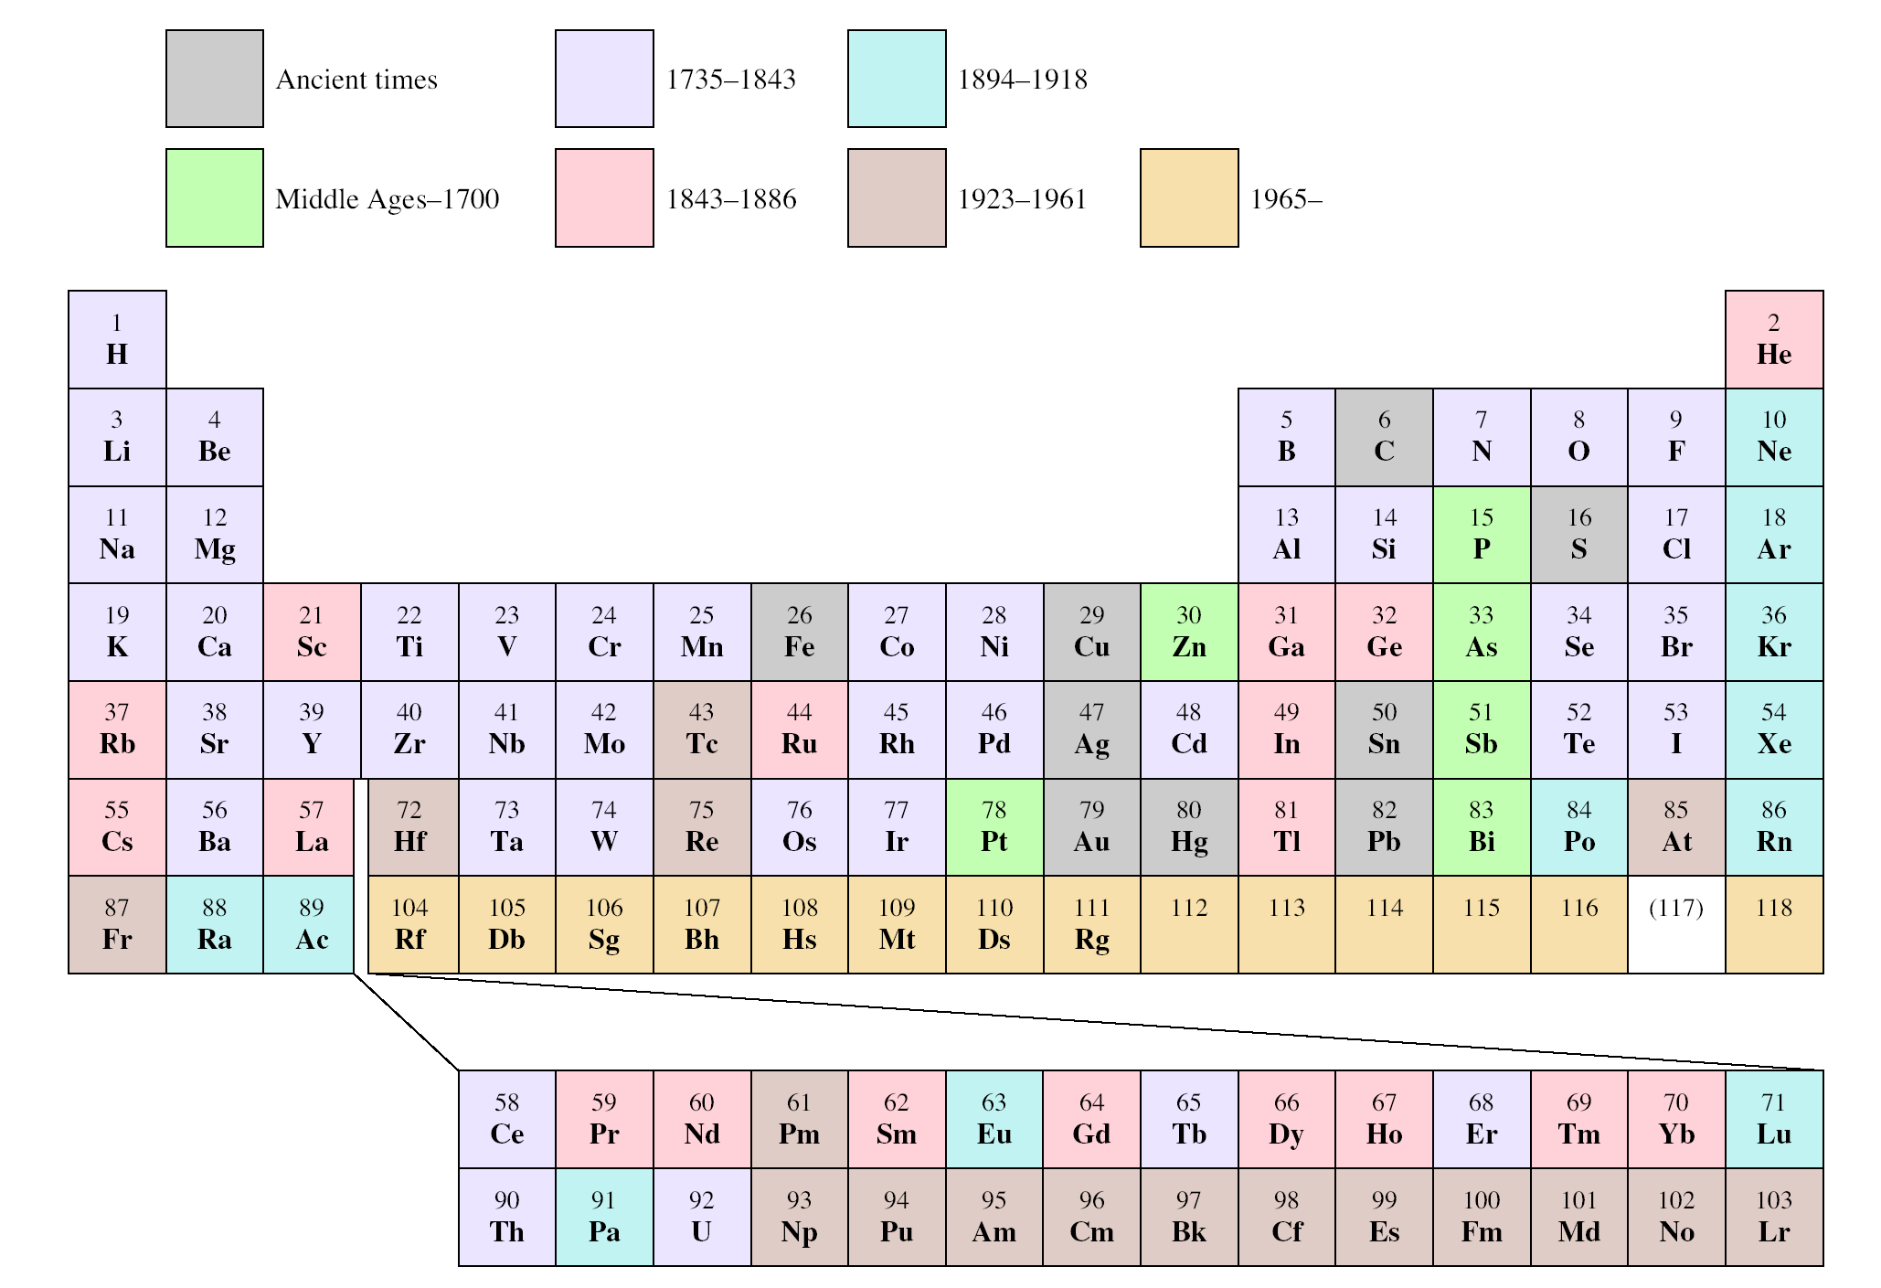
When the Elements Were Discovered

Slide 3
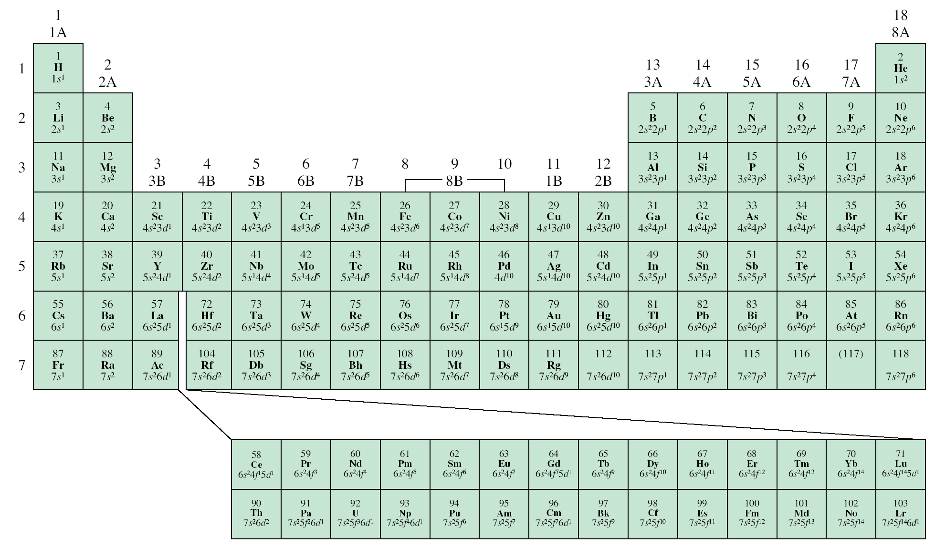
Ground State Electron Configurations of the Elements
ns¹
ns²np⁶
ns²np¹
ns²np²
ns²np³
ns²np⁴
ns²np⁵
ns²
d¹
d⁵
d¹⁰
4f
5f

Slide 4
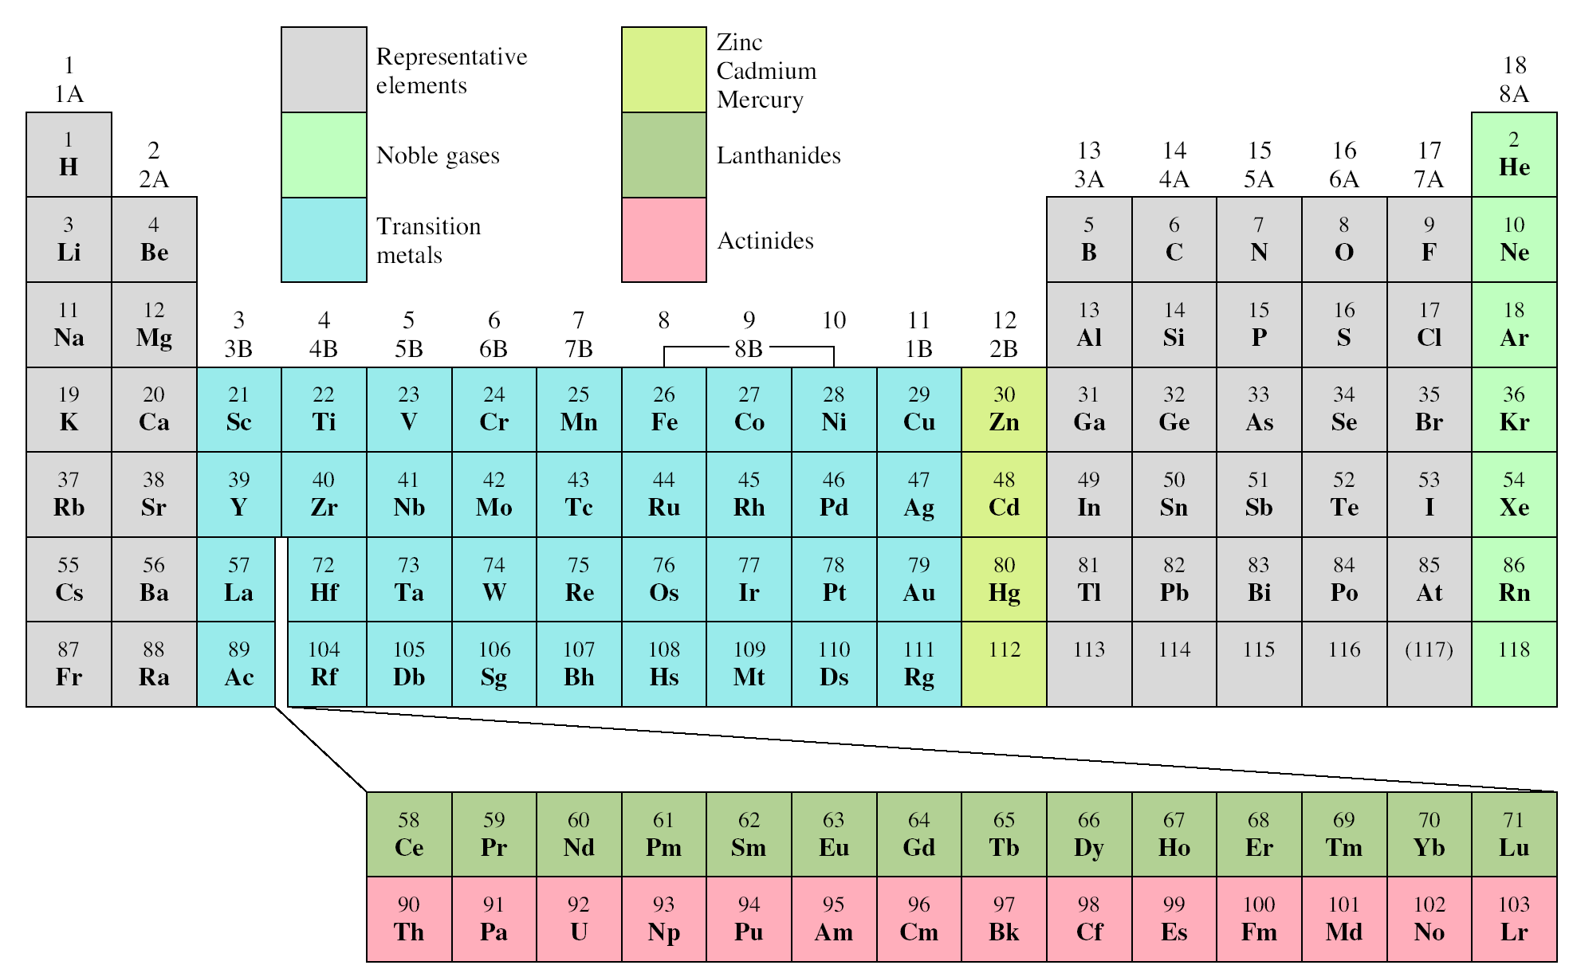
Classification of the Elements

Slide 5
Electron Configurations of Cations and Anions
Of Representative Elements
Na [Ne]3s¹
Na⁺ [Ne]
Atoms lose electrons so that cation has a noble-gas outer electron configuration.
Ca [Ar]4s²
Ca²⁺ [Ar]
Al [Ne]3s²3p¹
Al³⁺ [Ne]
H 1s¹
H⁻ 1s² or [He]
Atoms gain electrons so that anion has a noble-gas outer electron configuration.
F 1s²2s²2p⁵
F⁻ 1s²2s²2p⁶ or [Ne]
O 1s²2s²2p⁴
O²⁻ 1s²2s²2p⁶ or [Ne]
N 1s²2s²2p³
N³⁻ 1s²2s²2p⁶ or [Ne]

Slide 6
Cations and Anions Of Representative Elements
+1
+2
+3
-3
-2
-1

Slide 7
Isoelectronic: have the same number of electrons, and hence the same ground-state electron configuration
Na⁺: [Ne]
Al³⁺: [Ne]
F⁻: 1s²2s²2p⁶ or [Ne]
O²⁻: 1s²2s²2p⁶ or [Ne]
N³⁻: 1s²2s²2p⁶ or [Ne]
Na⁺, Al³⁺, F⁻, O²⁻, and N³⁻ are all isoelectronic with Ne electron configuration
What neutral atom is isoelectronic with H⁻ ?
H⁻: 1s²
same electron configuration as He

Slide 8
Electron Configurations of Cations of Transition Metals
When a cation is formed from an atom of a transition metal, electrons are always removed first from the highest ns orbital and then from the (n – 1)d orbitals.
Fe: [Ar]4s²3d⁶
Mn: [Ar]4s²3d⁵
Fe²⁺: [Ar]4s⁰3d⁶ or [Ar]3d⁶
Mn²⁺: [Ar]4s⁰3d⁵ or [Ar]3d⁵
Fe³⁺: [Ar]4s⁰3d⁵ or [Ar]3d⁵

Slide 9
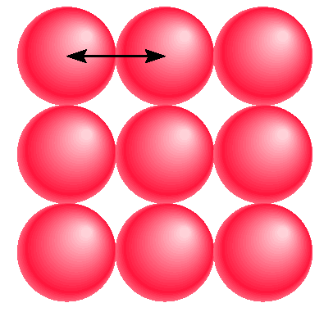
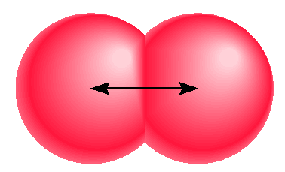

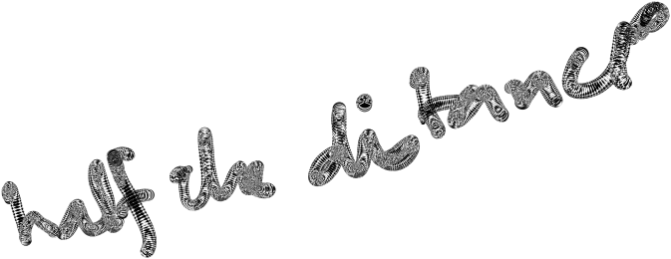

Atomic Radii
Diatomic molecules
I₂
metallic radius
covalent radius

Slide 10
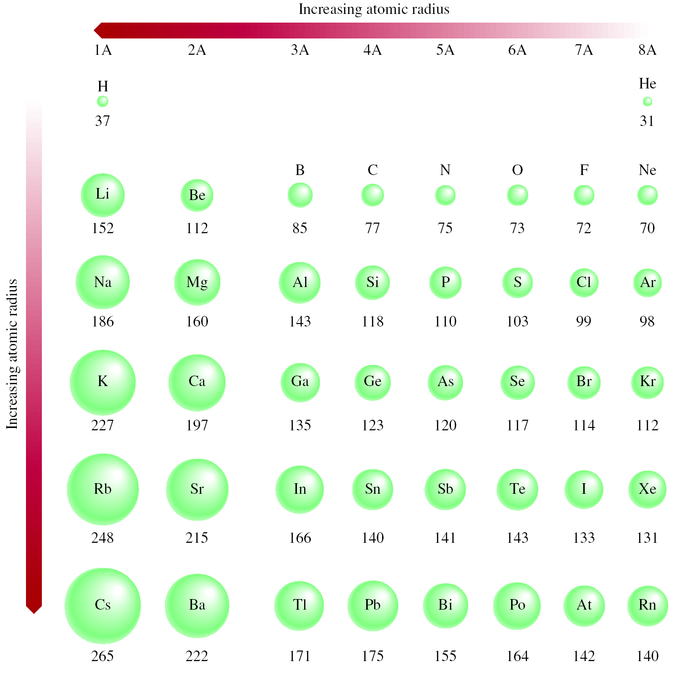
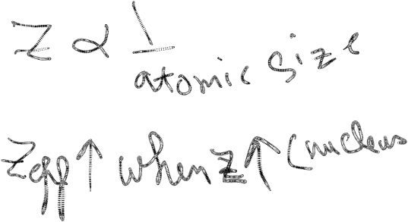
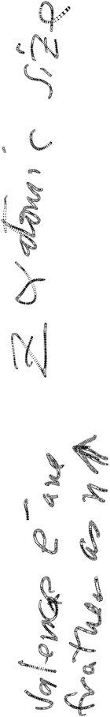



Slide 11
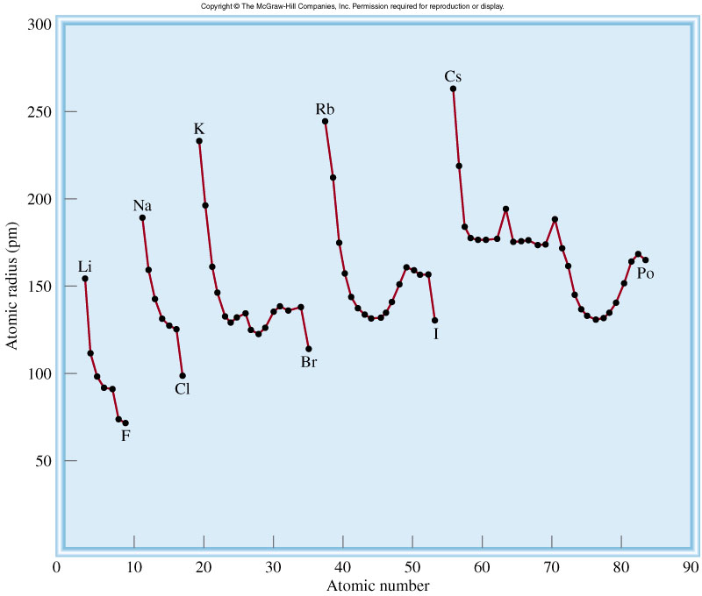
Trends in Atomic Radii

Slide 12
Ionization energy is the minimum energy (kJ/mol) required to remove an electron from a gaseous atom in its ground state.
I₁ + X _{(g)} X⁺_{(g)} + e⁻
I₁ first ionization energy
I₂ + X⁺_{(g)} X²⁺_{(g)} + e⁻
I₂ second ionization energy
I₃ + X²⁺_{(g)} X³⁺_{(g)} + e⁻
I₃ third ionization energy
I₁ < I₂ < I₃

Slide 13
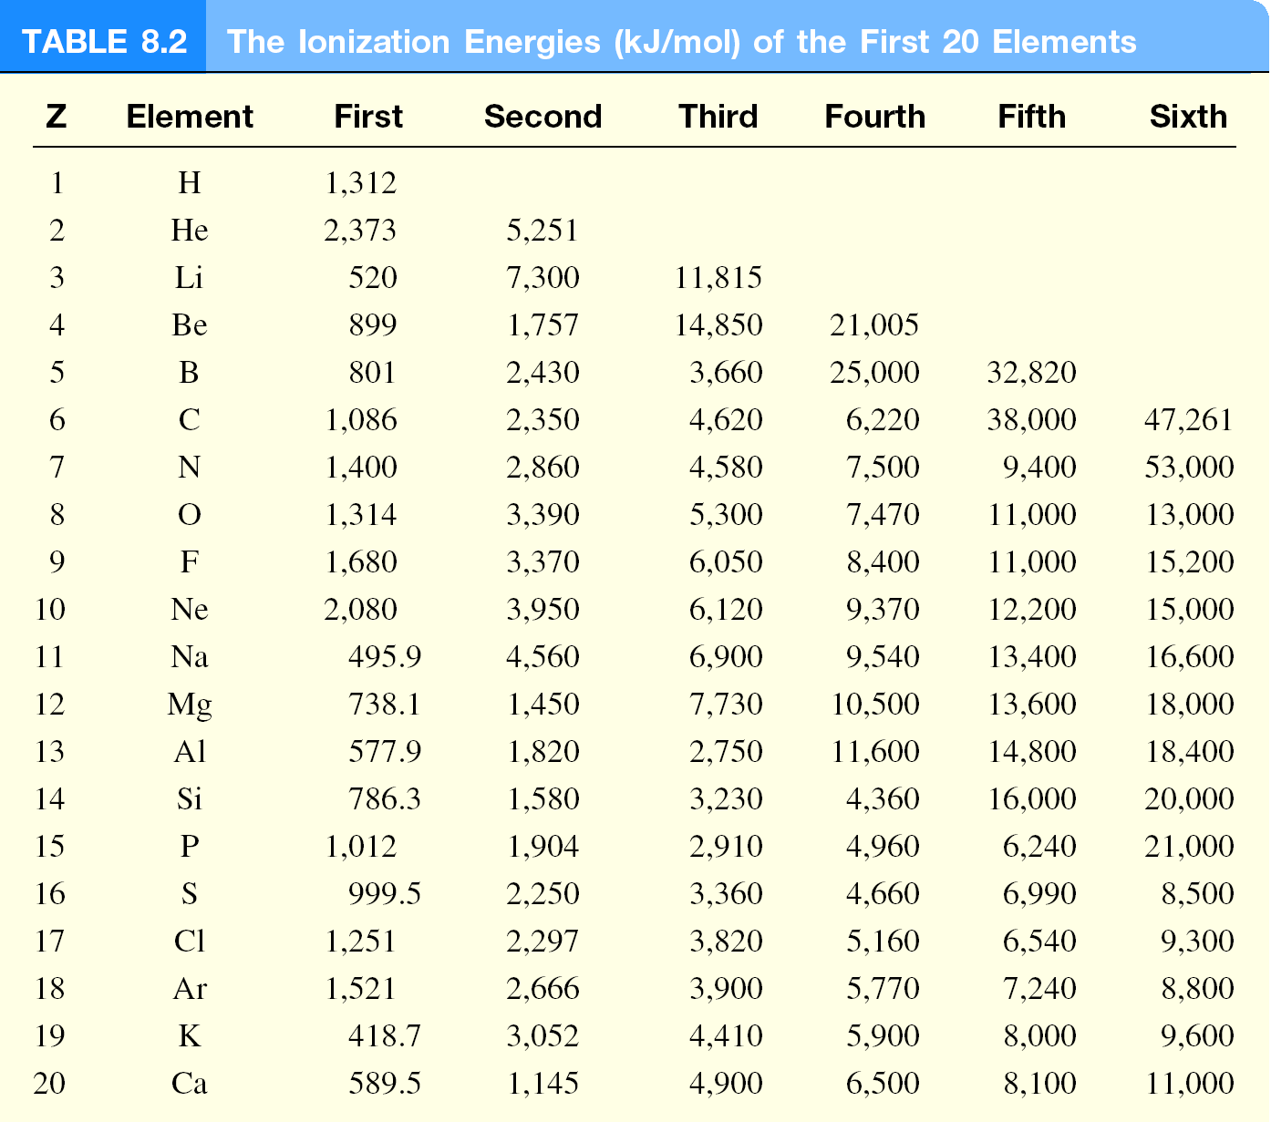

Slide 14
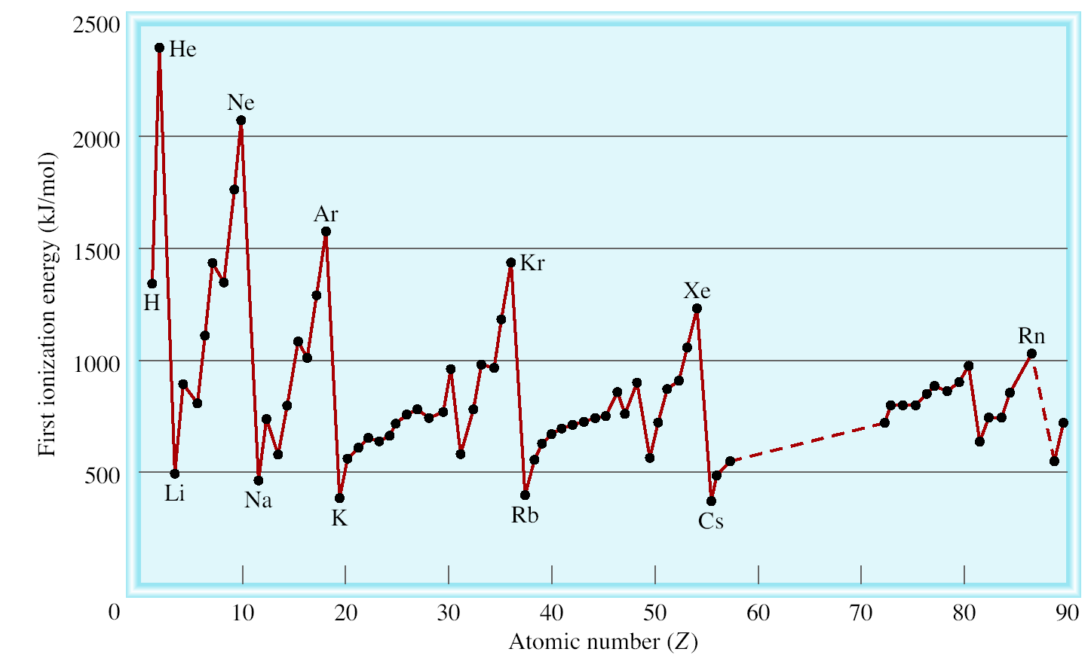
Variation of the First Ionization Energy with Atomic Number
Filled n=1 shell
Filled n=2 shell
Filled n=3 shell
Filled n=4 shell
Filled n=5 shell

Slide 15
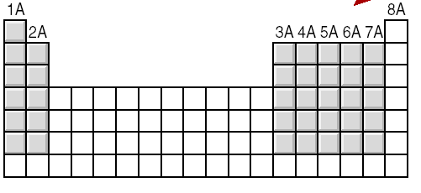
General Trends in First Ionization Energies
Increasing First Ionization Energy
Increasing First Ionization Energy

Slide 16
Electron affinity is the negative of the energy change that occurs when an electron is accepted by an atom in the gaseous state to form an anion.
X _{(g)} + e⁻ X⁻_{(g)}
F _{(g)} + e⁻ X⁻_{(g)}
ΔH = -328 kJ/mol
EA = +328 kJ/mol
O _{(g)} + e⁻ O⁻_{(g)}
ΔH = -141 kJ/mol
EA = +141 kJ/mol

Slide 17
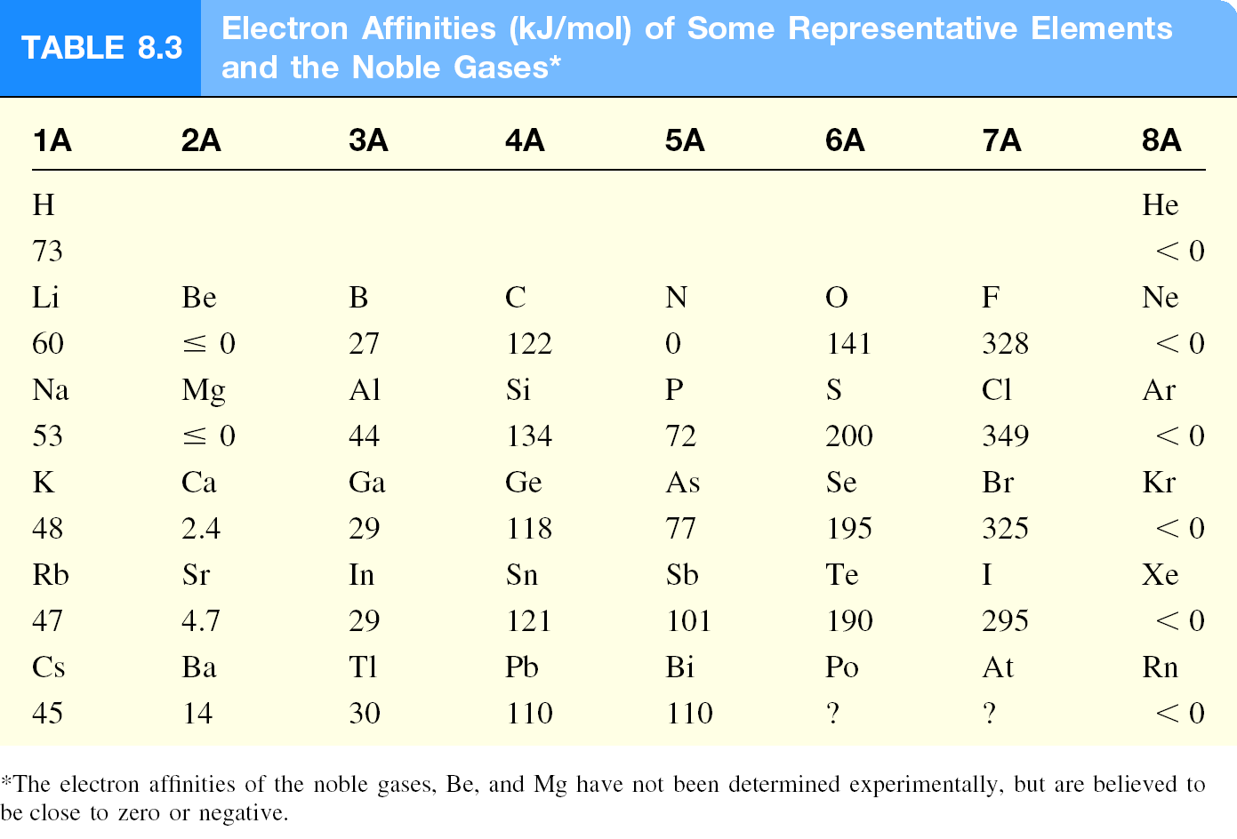

Slide 18
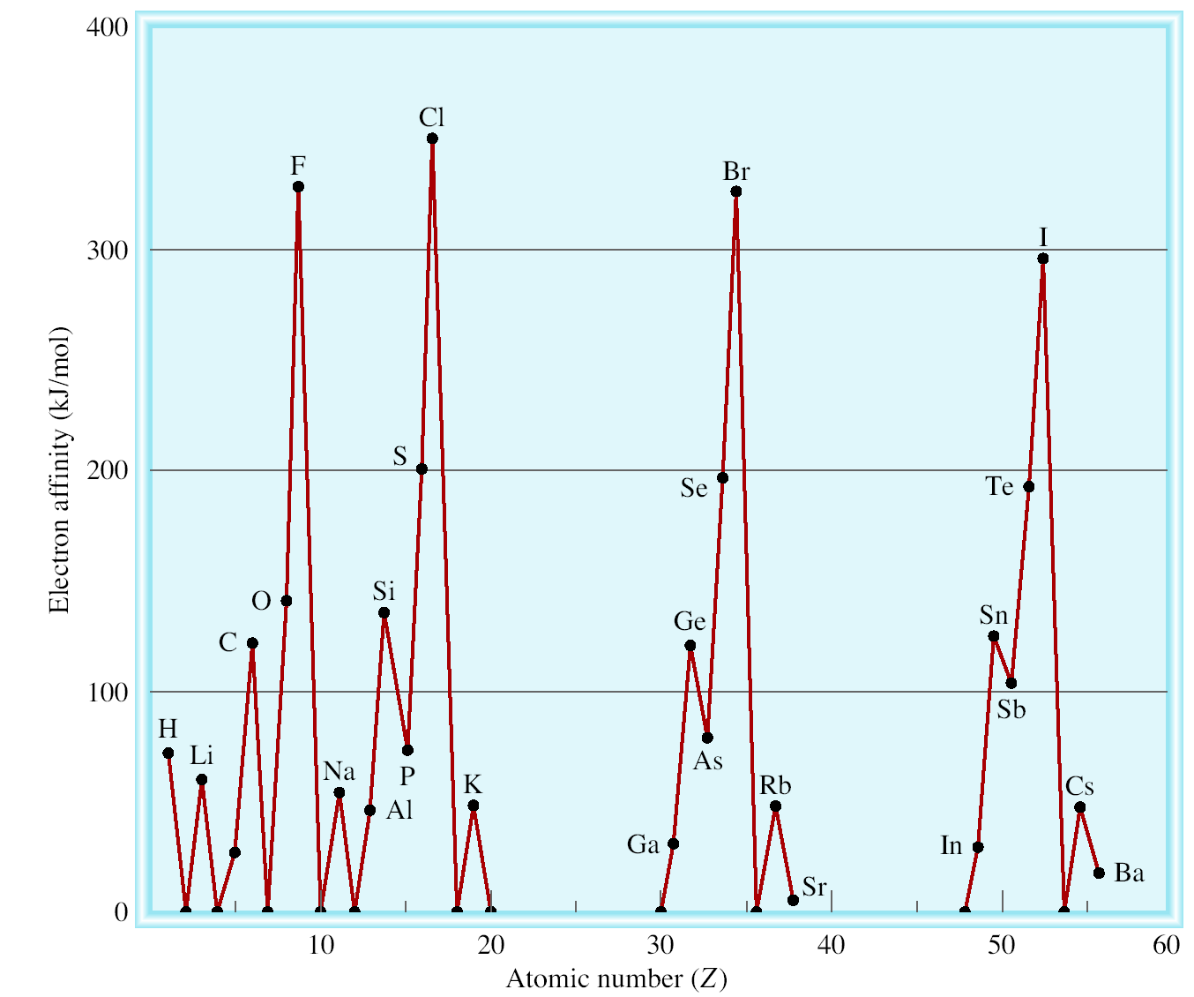
Variation of Electron Affinity With Atomic Number (H – Ba)

